Slide 1
Post-Training LLMs in 2025
Guiyao Tie, Zeli Zhao, Dingjie Song, Fuyang Wei, Rong Zhou, Yurou Dai, Wen Yin, Zhejian Yang, Jiangyue Yan, Yao Su, Zhenhan Dai, Yifeng Xie, Yihan Cao, Lichao Sun, Pan Zhou, Lifang He, Hechang Chen, Yu Zhang, Qingsong Wen, Tianming Liu, Neil Zhenqiang Gong, Jiliang Tang, Caiming Xiong, Heng Ji, Philip S. Yu, Jianfeng Gao
Presented by: Nikhil Khanchandani

Slide 2
Table of contents
01
02
03
04
Introduction
Why Post-Training Matters
Post-Training Taxonomy
Supervised Fine-Tuning

Slide 3
Table of contents
05
06
07
08
Preference Optimization
Reinforcement Learning with Human Feedback
Reasoning Techniques
LLM Agents & Tool Use

Slide 4
Table of contents
09
10
11
12
LLM Evaluation
Safety
What Works Best
Conclusion

Slide 5
01
Introduction

Slide 6
Introduction
Survey of how LLMs are improved after pretraining
Covers alignment, reasoning, safety, tool use, and efficiency
Focuses on practical techniques used in modern LLMs
Goal: explain how models actually become usable in applications

Slide 7
02
Why Post-Training Matters

Slide 8

Why Post-Training Matters
Bigger models aren’t enough anymore
Post-training shapes model behavior
Helps LLMs:
follow instructions
reason more clearly
stay safe
use tools
run efficiently
This is the “engineering layer” of modern LLM development

Slide 9
03
Post-Training Taxonomy

Slide 10
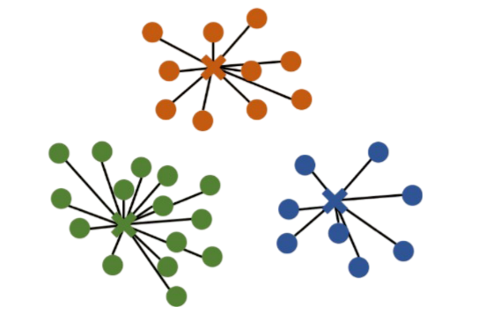
Post-Training Taxonomy
Four major areas:
Supervised Fine-Tuning (SFT)
Preference Optimization
Reinforcement Learning
Reasoning-focused methods
Efficiency improvements
All modern models use a combination of these

Slide 11
04
Supervised Fine-Tuning

Slide 12
Supervised Fine-Tuning
Trains model on instruction data
Helps with formatting, following prompts
Basic alignment step
Foundation of most post-trained LLMs

Slide 13
05
Preference Optimization

Slide 14
Preference Optimization
Teaches model to choose better answers
Direct Preference Optimization (DPO) is most common
Simpler than RLHF
Improves tone, helpfulness, and reasoning

Slide 15
06
RLHF (Reinforcement Learning with Human Feedback)

Slide 16
RLHF (Reinforcement Learning with Human Feedback)
Used less heavily now
Good for safety and long responses
More expensive and complex
Often used as a polishing step

Slide 17
07
Reasoning Techniques

Slide 18
Reasoning Techniques
Chain-of-Thought (step-by-step answers)
Self-Consistency (sample multiple solutions)
Reflection / self-correction
Structured reasoning (trees, graphs, planning)
Helps with math, logic, multi-step questions

Slide 19
08
LLM Agents & Tool Use

Slide 20

LLM Agents & Tool Use
Post-training enables tool use
Examples:
web search
calculators
code execution
RAG / retrieval
Planning patterns: ReAct, Plan-Execute
Memory systems help with long tasks

Slide 21
09
LLM Evaluation

Slide 22
LLM Evaluation
Harder than it looks:
benchmark saturation
contamination issues
LLM judges can be inconsistent
Better evaluation:
multiple seeds
human checks
open-ended “arena” comparisons
Ablation studies show what actually helped

Slide 23
10
Safety

Slide 24
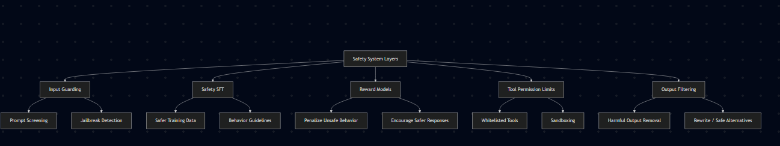
Safety
Common risks:
jailbreaks
harmful outputs
misinformation
privacy leaks
Safety methods:
safety-tuned SFT datasets
reward models
guardrails and policies
restricted tool permissions

Slide 25
11
What Works Best

Slide 26
What Works Best
Chain-of-Thought + Self-Consistency
Reflection-based methods
ReAct and Plan-Execute for agents
Quantization (especially 4-bit)
Distillation for smaller models
LoRA for efficient tuning
These show up in many leaderboard models

Slide 27
12
Conclusion

Slide 28
Conclusion
Post-training defines modern LLM quality
Most improvements come from smarter post-training, not bigger models
Agents, memory, and evaluation are becoming core parts of development
Understanding these techniques helps build better real-world applications

